Slide 1
OTC Sales Process

Slide 2
Lesson Objectives
Purpose
Use
Challenges
SD Sales
Pre Sales
Sales Order
Outline Agreement
Copy Controls
Sales Document Types
Sales Document Type-Controls
Item Category
Item Category-Controls
Schedule Line Categories
Schedule Line Category-Controls
Notes:
Add instructor notes here.

Slide 3
Lesson Objectives
Sales-Transactions
Inquiry
Quotation
Sales Order-Header
Sales Order-Header Views
Sales Order-Item
Sales Order-Item Views
Sales Order-Environment
Sales Order-Enhanced Functions
Copy Controls-Header Level
Copy Controls-Item Level
Copy Control-Schedule Line Level
Transaction Codes
Additional Info
Notes:
Add instructor notes here.

Slide 4

Purpose
The sales department of any organization carries many activities, each involving a great deal of variation in and of itself
This ranges from processing requests for quotations, sales orders to pricing, credit and product availability

Slide 5
Purpose(Continued…)
The employees in a sales department are involved in many activities such as
Maintain basic information about the customers, products and services that they consume
Interacting with customers
Answer to their queries
Provide them estimates
Give updates of availability of products
Offer appropriate products based on the buying pattern of the customer
Perform order entry in the system

Slide 6
Use
Inquiry and quotation can be used to:
Track lost sales
Record pre-sales data to help negotiate contract
Sell goods and services to large organizations that require documentation of the entire process
Serve as a source document that is later reference for the information
During the sales order processing system checks automatically whether the material is available for the requested delivery date & if necessary, transfers the requirements to materials planning, Shipping deadlines & shipping points are determined in delivery scheduling
Sales documents automatically proposes data from the relevant material master records, such as data for pricing, tax determination, and weight and volume determination

Slide 7

Challenges
The challenges in the Sales are:
Different pricing for different customers
Delivery date confirmation with assured quantities
Online status update and Document history
Tracking of Materials and customer accounts
Updating of Information system to plan and control of sales
Monitor customer credit worthiness
Monitor follow up activities from sales support

Slide 8
SD Sales
SD Sales includes:
Pre-Sales: Inquiries & Quotations
Order: Sales Order, Rush Order, Cash Sales, etc.
Outline Agreement: Contract & Scheduling Agreement

Slide 9

Pre-Sales
Inquiry – Non-Binding Agreement
For example, a customer inquires whether we have a certain product in our warehouse, how much it will cost, or whether the product will be available for a certain date. The inquiry will not be sent to the customer
Quotation – Binding Agreement from <Client>
A quotation presents the customer with a legally binding offer for delivering a product or service within certain fixed conditions, such as the validity period and the terms and conditions

Slide 10
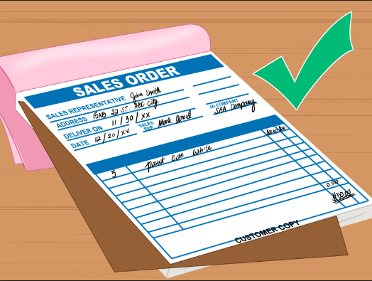
Sales Order
Sales order is a contractual agreement between a organization and a customer about delivering products or providing a service for defined prices, quantities and times
Sales Orders normally contain information on Customer, Material, customer material information, Pricing conditions for each item, Delivery dates and quantities for each item, Shipping processing information and Billing information

Slide 11
Sales Order - Structure
All sales documents have basically the same structure.
They are made up of:
Header
Item
Schedule Line
Sales Order
Header
Item 1
Schedule line 1
Item 2
Schedule line 1
Schedule line 1
Schedule line 1

Slide 12


Header Data
The data in the document header is valid for the entire document. This data is primarily customer related data
Sales Order
Header
Sold-to party: Ship-to party:
1000006
1000006
Req. Delivery Date: 7/28/00
For example,
Sold-to Party, Ship-to party
Purchase Order Number
Sales Area Data
Payment Terms
Pricing elements for the entire document
Order Status
Currency: USD
Item 1
 | Schedule line 1
Item 2
Schedule line 1
Schedule line 1
Schedule line 1

Slide 13

Item Data
Item data contain line item relevant information and is specific to an item
Sales Order
Header
The item data includes:
Material number
Quantity
Ship-to Party
Reason for rejection
Item level text
Item level status
Plant and storage location
Pricing conditions for the individual items
Item 1
Item 2

Slide 14

Schedule Line Data
Schedule line contain delivery quantities and delivery dates
Sales Order
In sales documents where delivery data is not relevant, for eg, contracts, credit & debit memo requests, the system does not create any schedule lines
Header
Item 1
 | Schedule line 1
Every item that is to have an outbound delivery must have at least a single schedule line
Item 2
Schedule line 1
Schedule line 1
Schedule line 1
A single line item in the sales order can
have multiple schedule lines, for e.g.,
when the quantity ordered is to be
delivered in several partial deliveries on different dates

Slide 15
Sales – Associated Functions
During sales order processing, the system carries out basic functions, such as:
Determining the delivering plant, Shipping point & Route automatically
Availability check System’s ability to automatically determine a delivery
(promise) date for a sales order
Delivery Scheduling – determines lead times for delivery processing
Transfer of requirements - determines the item requirements to be passed to materials planning (MRP)
Pricing- indicates how a price should be determined for the sales order item
Sales Information System - dictates how the sales information system
is updated with sales order information to plan and control sales
Checking Credit Limits

Slide 16
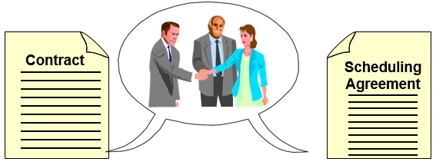
Outline Agreements
Contracts : Outline agreements with fixed quantity or value that a customer promises to order over a specified period of time, as well as the price involved. It requires a release order to make a delivery. Pricing (procedure and/or discounts) is copied to release order from the contract
Scheduling Agreements : Outline agreements with determined schedule lines. A delivery note is created directly from the scheduling agreement (release order is not required)

Slide 17

Copy Controls
Through Copy Control you can,
Restrict the sales documents allowed for copy
Control the flow of data at header, item and schedule line level
To control the copying procedure, at each level you create:
Data Transfer Routines: These routines control how fields are copied from the reference document
Copying Requirements : Here you define requirements that are checked when you create a document with reference. If these requirements are not met in a particular case, the system issues a warning or error message and if necessary, terminates processing
Quantity and Value updates in document flow

Slide 18
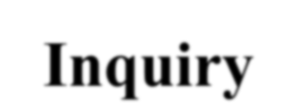













Sales Document Types
IN
Inquiry
The sales document types - represent the different business transactions in Sales
QT
Quotation
OR
Standard Order
The customizing for a sales document type controls the behavior of a sales document at the header level
RO
Rush Order
CS
Cash Sale
DS
Scheduling Agreement
CQ
Quantity Contract
IMG ->Sales and Distribution -> Sales -> Sales Documents -> Sales document header -> Define sales document types

Slide 19
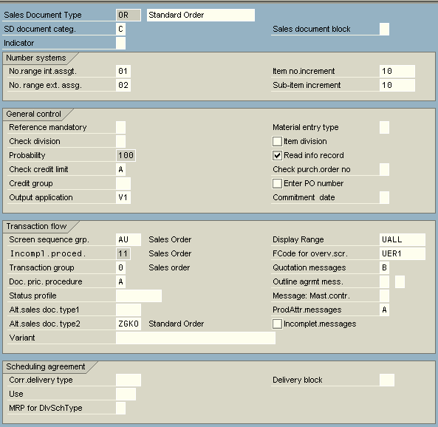
Sales Document Type - Controls
The definition and configuration of sales document types can be divided into three parts:
Definition of the sales document types themselves (for e.g., Standard order OR)
Definition of additional sales document functions (for example, number ranges for internal and external assignment, Item no. increment)
Additional Configurations must be done outside of the document type is maintained as basic functions (such as pricing, partners, output , and so on, for example, Pricing). The procedure is then linked to the document type.
You can activate various checks, such as messages about open quotations or outline agreements, searches for customer material info records, or credit limit checks.
Note: Activating checks can affect the system performance.

Slide 20
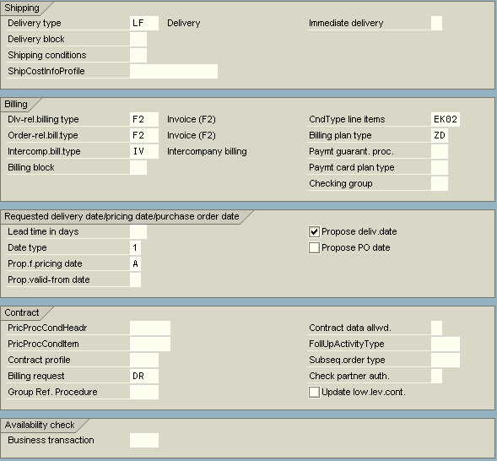
Sales Document Type - Controls
The sales document types are not isolated but are always closely linked with delivery types and billing types
Also the information relevant for
enhancement for contracts
In addition to the definition and control of the sales document types themselves, you must also take the following settings into account:
language conversion
number ranges
screen sequence groups
field selection per document header
blocks per sales document type
reasons for rejection
usage indicators
Assign Sales area to Sales Document types

Slide 21
















Item Category
AFN
The item category controls the function of the item in the sales document.
Standard Item
AGN
TAN
For example, the item category controls the type and scope of:
Pricing
Billing
Delivery
AFNN
AGNN
Item Free of Charge
AF = Inquiry
TA = Sales Order AG = Quotation
TANN
Items in stock, and value and text items
are item categories.
AFX
AGX
Non-stock Item
The item category is a 4 digit key. The first 2 characters provides a clue to sales document type and the last two for the use of the item category.
TAX
AFTX
AGTX
Text Item
TATX
To configure Item Categories: IMG ->Sales and Distribution -> Sales -> Sales Documents -> Sales document Item -> Define Item Categories

Slide 22
Item Categories - Controls
The Item Category on a sales document is determined on the basis of sales document type and item category group (material master)
The Item Category on a sales document controls:
Whether pricing applies to the item
Whether and how an item is billed
Whether schedule lines are allowed
Whether the item is a text/value or material item
Whether the item is relevant for delivery (used only if the item is a text/value item)
Which data should appear in the incompletion log
Whether the item business data can differ from the header business data on the sales document
The Item Category for the sub item on a sales document is determined by Sales document type, Item category group and Item category of higher level item

Slide 23
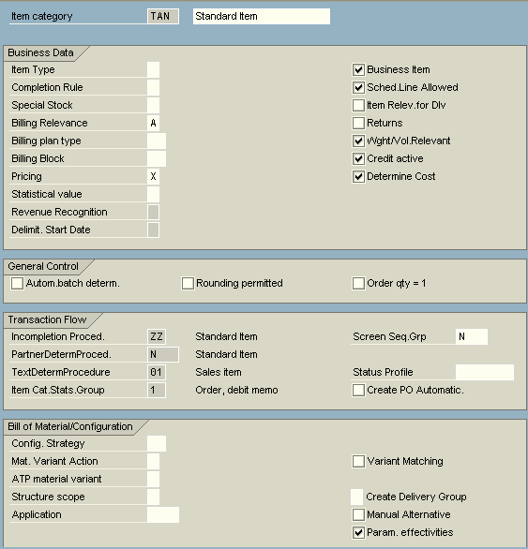
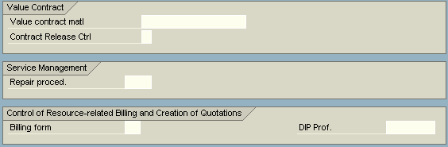
Item Categories - Controls

Slide 24
Schedule Line Categories
Schedule lines is the division of an item in a sales document according to date and quantity. The control of the schedule lines depends on the schedule line category
IMG ->Sales and Distribution -> Sales ->Sales Documents ->Schedule Lines -> Define Schedule Line Categories

Slide 25


Schedule Line Categories
AT
Inquiry schedule line
BN
No MRP
CN
A = Inquiry
B = Quotation C = Sales Order D = Returns
BP
Deterministic MRP
CP
BT
No inventory management No goods issue
CT
BV
Consumption-driven MRP
CV
DN
Returns

Slide 26
Schedule Line Category - Controls
The Schedule Line Category on a sales document controls:
Whether requirements should be passed on to MRP
Whether an availability check should be carried out
Whether an item is relevant for delivery (Example, a third party item or a quotation would have schedule lines but would not be relevant for delivery)
Which data should appear in the Incompletion log
A movement type for posting quantities and changes in value to inventory accounting
The movement type is only relevant to items or schedule lines which result in a stock movement
To generate purchase requisitions automatically in MM ( Purchasing) you use the fields Order type, Purch. req. with del. Scheduling, Item category and account assignment (for ex. Schedule line category CS)
The Schedule Line Category is dependent on the item category and the MRP Type (MRP Screen of material master)

Slide 27
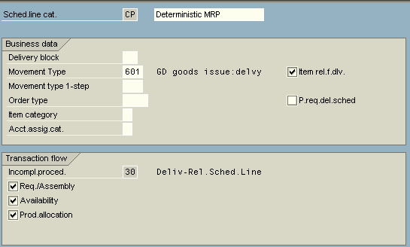
Schedule Line Category - Controls

Slide 28
Sales - Transactions
Transaction Codes | Application
VA11 / 12 / 13 | Create / Change / Display Inquiry
VA21 / 22 / 23 | Create / Change / Display Quotation
VA41 / 42 / 43 | Create / Change / Display Contract
VA31 / 32 / 33 | Create / Change / Display Scheduling Agreement
VA01 / 02 / 03 | Create / Change / Display Sales Order

Slide 29
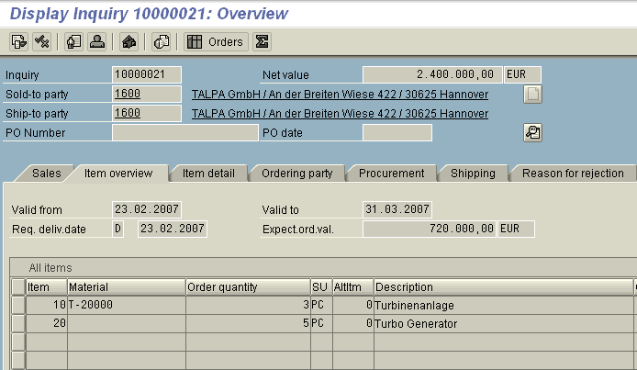
Inquiry
Inquiry : Customer contact records which capture pre-sales information
Can be for material or text items
Serve as system references for future activity
Serve as follow up for business that did not happen
The validity period can be used as a processing limit
Material entered only with description text -
no material master record required

Slide 30
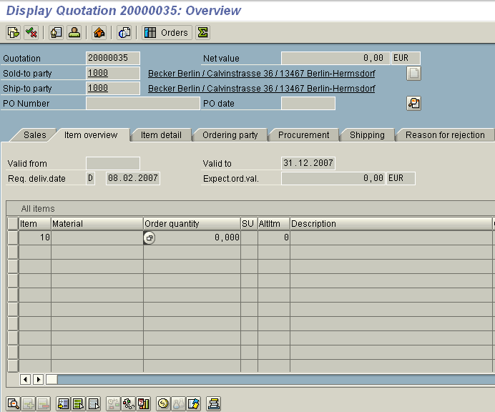
Quotation
A quotation can be created with or without reference to an inquiry
Quotations are offers from a sales area to a customer for delivering materials or providing services under specified conditions
Quotations are legally binding throughout the given validity period

Slide 31
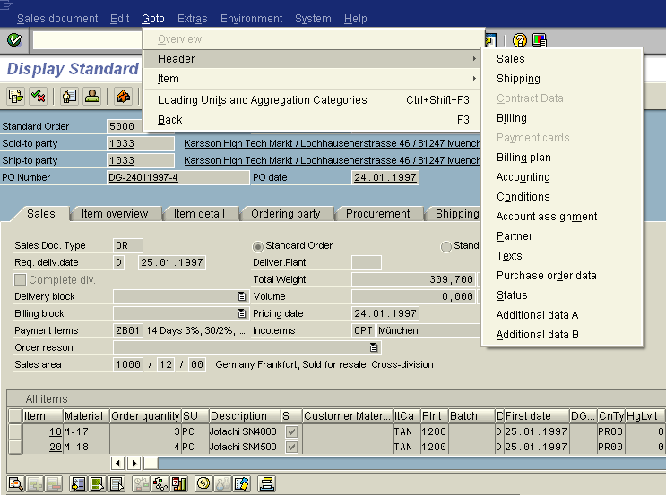
Sales Order - Header

Slide 32
Sales Order – Header Views
Important Fields | Screen | Application
Sold to Party | Main Screen | Each sales order is assigned to unique sales area (sales organization, distribution channel, or division). If there is master data for the sold-to party in several sales areas, a selection screen appears where you can choose the sales area you require. If there are several possible sold-to parties for the ship-to party, the system displays a selection screen with the possible alternatives.
Order type | Sales View | A classification that distinguishes between different types of sales document.
Blocking Document | Sales View | In sales orders, you can block the transactions for shipping or for billing. Billing block can be set in the document header, and also in the individual item.
Reason for Rejection | Sales View | You can reject items in sales documents. This gives the items the status of completed. The business transaction thus be concluded without deleting the item. Also a reason for rejection allows you to find out what your customer thinks of your products during a certain time period.
Account Assignment category | Billing | Using the account assignment criteria as a variable G/L account can be determined

Slide 33
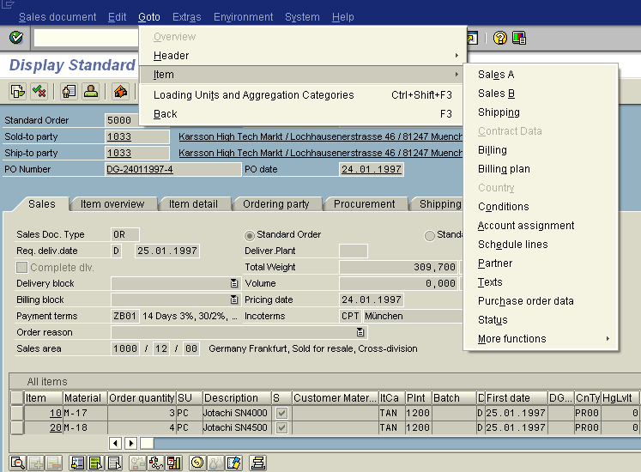
Sales Order - Item

Slide 34
Sales Order – Item Views
Important Fields | Screen | Application
Material | Sales | For each material in the sales order, the system automatically proposes data from the relevant material master records, such as data for pricing, delivery, scheduling, availability check, tax determination, weight and volume determination.
Delivering Plant | Sales | A plant is required to source inventory for a sales order. The plant can be defaulted on the priority to customer material information record, then look in the ship to party customer master and then the material master.
Shipping Point | Shipping | The shipping point is automatically determined on the combination of the delivering plant based on plant determination or manual override of the sales order item, the shipping condition of the sold to party customer master record (Sales Area Data, view: Shipping) and the loading group in the material master (Sales: General/Plant Data View)
Shipping condition | Shipping | The shipping condition in the customer master are used to define a customers delivery requirements (Sales Area Data, view: Shipping).
Route | Shipping | A Route is transportation path of an outbound delivery from the delivering plant to the ship-to party. SAP R/3 uses four data element as search keys for determining the route automatically. These data elements are : The departure transportation Zone found in customizing for the shipping point definition, the shipping condition found in the customer master of the sold party (Sales Area Data; Shipping view), the transportation group found in the material master (Sales: General/Plant Data View) and the destination transportation zone found in the ship-to party master data record (General/Plant; Address view)
Pricing | Condition | The PR00 is defined as the mandatory pricing condition.

Slide 35
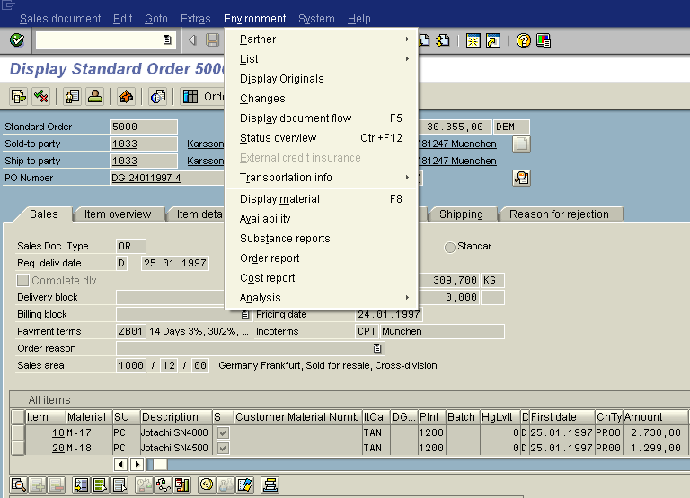
Sales Order - Environment

Slide 36
Sales Order – Environment
Important Fields | Menu | Application
Partner | Environment -> | This navigation menu helps you for displaying the customer master records sold to party, ship-to party, bill-to party, payer, credit account and sales summary.
List | Environment -> | This navigation give the list of sales documents such as inquiry, quotation, sales order, contract & scheduling agreement and item proposals. Online list display documents with a specific status, allow you to review and change documents.
Status Overview | Environment -> | This display the status of document both at Header & Each Item – Their Total processing – Being processed or completed and Delivery status – partially delivered or completed and rejection status – partially rejected or fully rejected.
Document Flow | Environment -> | Document flow are updated for the overall document and for individual items. You can branch directly to the display of a related documents and then return to the document flow.
Material | Environment -> | The material details in the material master can be view with this navigation.
Availability | Environment -> | This give the stock availability of the material.
Analysis | Environment -> | This menu path take you for account determination, material determination, free goods, listing and exclusion on /off status.

Slide 37
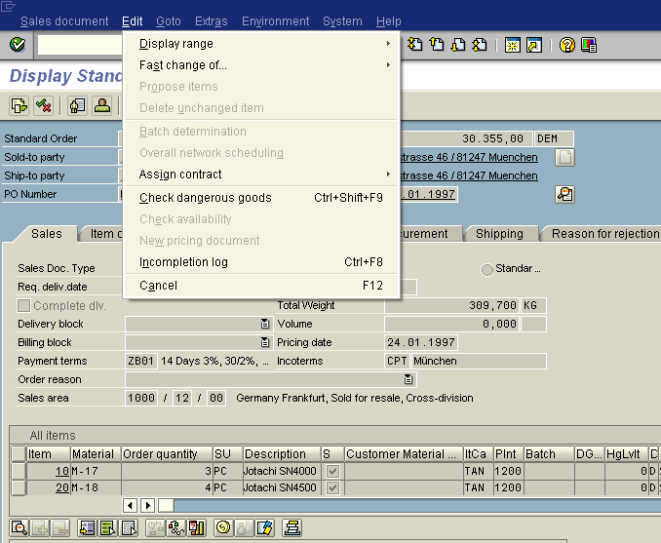
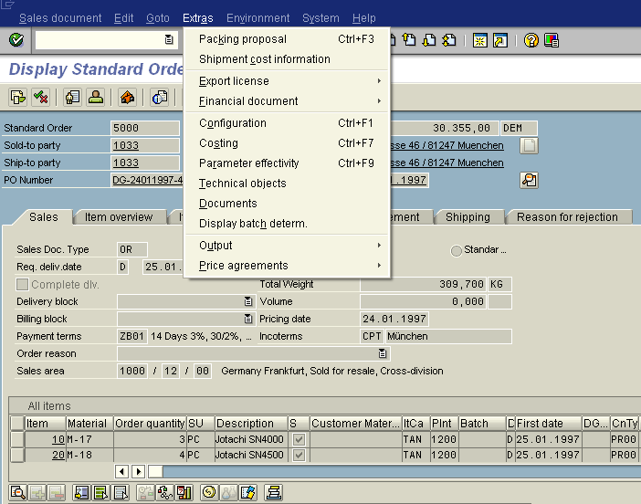
Sales Order – Enhanced Functions

Slide 38

Sales Order – Enhanced Functions
Important Fields | Menu | Application
Fast Change of | Edit -> | The fast change function allows you to change more than one item at once during sales order processing. This applies to the reason for rejection, delivery block, billing block, delivery date, delivery priority and delivery plant.
Sales Summary | Icon | The sales summary helps to create documents a variety of relevant information about the customer. The information in the sales summary is grouped into info blocks on various topics such as Address, Key figures, Quick info, Contact person, Last SD document, Pricing etc.
Incompletion Log | Edit -> | An incompletion log is a list of all the data that has not yet been entered n the system, but that is essential to your company in a sales document.
Packing Proposal | Edit -> | Packing instructions can be entered into sales orders and scheduling agreements. Using this information, a packing proposal is created in the delivery.
Shipment cost information | Edit -> | Simulation of shipment cost can be carried out at sales order level to plan for the transport.

Slide 39
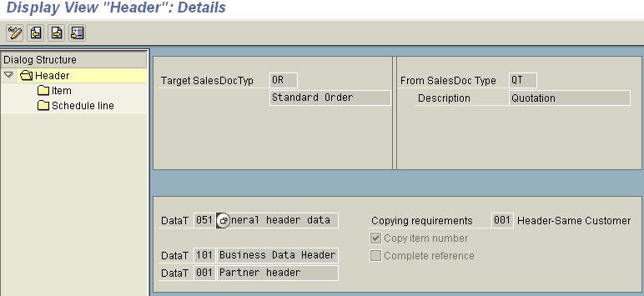
Copy Control – Header Level
Copying requirements that have been included in SAP R/3 SD are:
Header Level : Copying requirement 001 checks, for instance, whether the Sold-to Party an the sales area in the source and target documents are the same
IMG -> Sales & Distribution -> Sales -> Maintain Copy Controls for Sales Documents IMG -> Logistics Execution -> Shipping -> Copy Controls
IMG -> Sales & Distribution -> Billing -> Maintain Copy Controls for Billing Documents

Slide 40
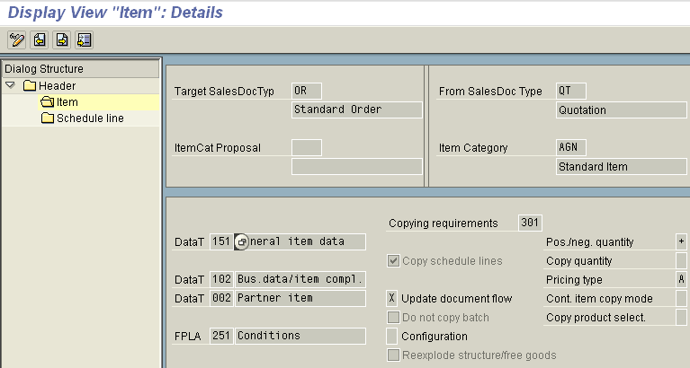
Copy Control – Item Level
Item Level : Copying requirement 301 checks, for instance, whether the item that is to be used as a copy has a reason for rejection or status completed

Slide 41
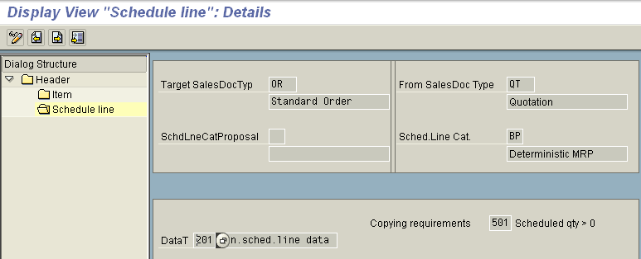
Copy Control – Schedule Line Level
Schedule Line Level : Copying requirement 501 ensures that only schedule lines with open quantity greater than zero are copied

Slide 42
Transaction Codes
VOV8 | Define Sales Document Type
VOV7 | Define Item Categories
VOV6 | Define Schedule Line Categories
VTAA | Copy Control from Sales Document to Sales Document
VTLA | Copy Control from Sales Document to Delivery Document
VTFA | Copy Control from Sales Document to Billing Document
VTFL | Copy Control from Delivery Document to Billing Document

Slide 43








Tips and Tricks
These Icons appear on most Sales Documents
Status Overview
Display Sales Summary
Display Sold-to Party
Display Item Detail
Page Down
New Session
View Availability
Item
Conditions
Create Item
Delete Item
Header Output View Reject Document
Item to top
Display Document Flow
List Sales Orders
Check Item Availability
Schedule Lines
Display Header Detail

Slide 44
Additional Info
Sales Orders can be entered without specifying the sales area, which is automatically determined from the customer master record
Sold to party can be created directly in the sales order transaction
It is also possible to enter a sales order with the ship-to party, as the system can use this to search and list all the potential sold-to parties

Slide 45
Additional Info
You can create default sold-to party by setting the indicator on the sold-to party in the customer master, or by following Extras -> Account group info ->Customer Types. and selecting Default SP
When the sold to party is changed, the changed value runs through the same checks as the initial entry. As a result , a variety of data is redetermined, such as customer master, customer material info record, texts, prices, output, plant and shipping point etc. There would be no changes if there are status – relevant preceding document or subsequent document
You can create your own data transfer routines and copy requirements using the transaction code VOFM

